Slide 1
MINOR PROJECT REPORT
ON
“Image Caption Generator Using Deep Learning”
Submitted in partial fulfillment of the requirements for the award of the degree of
Bachelor of technology In
Computer Science and Engineering
Under the guidance of : Submitted By:
Ms. Jyotsna Gurman Singh(111/CSE2/2019)
Harneet Singh(103/CSE2/2019)
Kuldeep Singh(117/CSE2/2019)
Sahibjot Singh(065/CSE2/2019)
GURU TEGH BAHADUR INSITUTE OF TECHNOLOGY
RAJOURI GARDEN, DELHI -110027
Affiliated To
GURU GOBIND SINGH INDRAPRASTHA UNIVERSITY

Slide 2
Introduction
Generating accurate captions for an image has remained as one of the major challenges in Artificial Intelligence with plenty of applications ranging from robotic vision to helping the visually impaired.
“Image caption generator": the name itself suggests that we aim to build an optimal system which can generate semantically and grammatically accurate captions for an image.
Researchers have been involved in finding an efficient way to make better predictions, therefore we have discussed a few methods to achieve good results.
There are two phases: feature extraction from the image using Convolutional Neural Networks (CNN) and generating sentences in natural language based on the image using LSTM (Long Short Term Memory) for framing our sentences from the input images given.

Slide 3
Objective
Image captioning has various applications such as recommendations in editing applications, usage in virtual assistants, for image indexing.
Probably, will be useful in cases/fields where text is most used and with the use of this, you can infer/generate text from images.
There are many NLP applications right now, which extract insights/summary from a given text data or an essay etc.
The same benefits can be obtained by people who would benefit from automated insights from images.

Slide 4
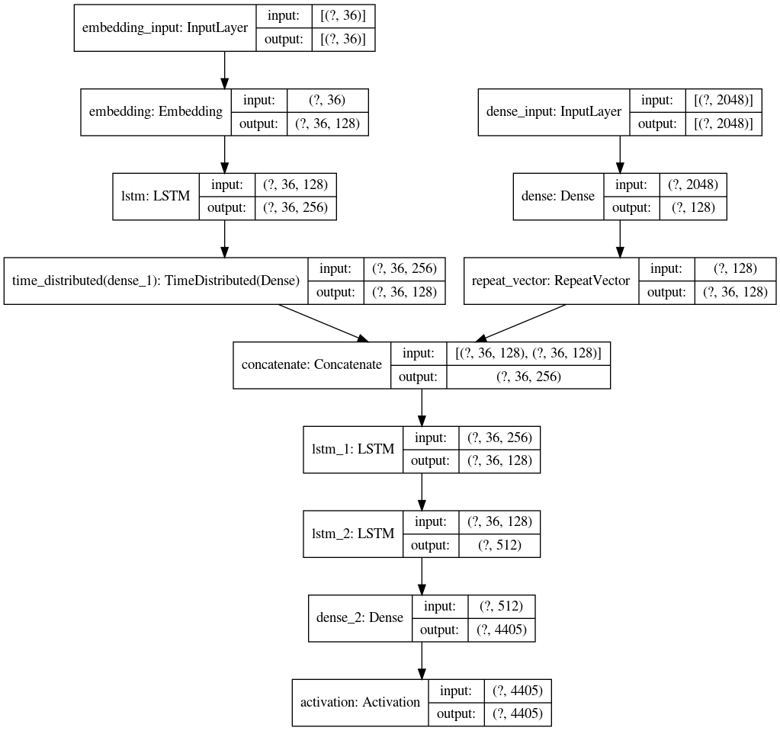
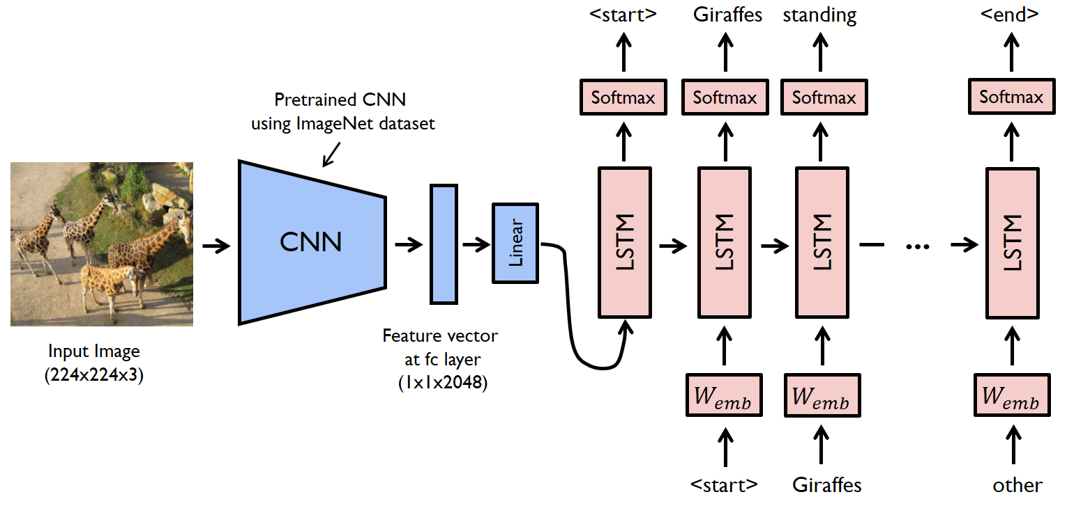
Model Diagram

Slide 5
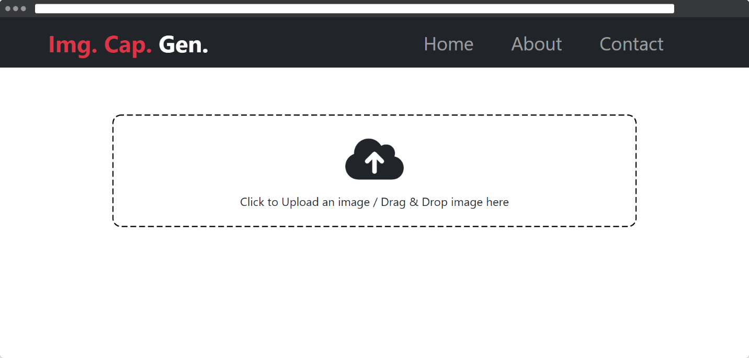
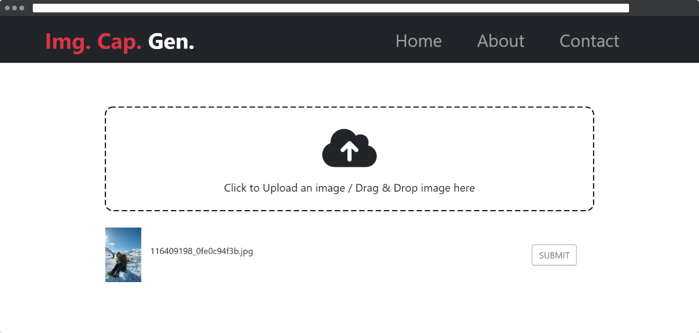
User interface samples

Slide 6
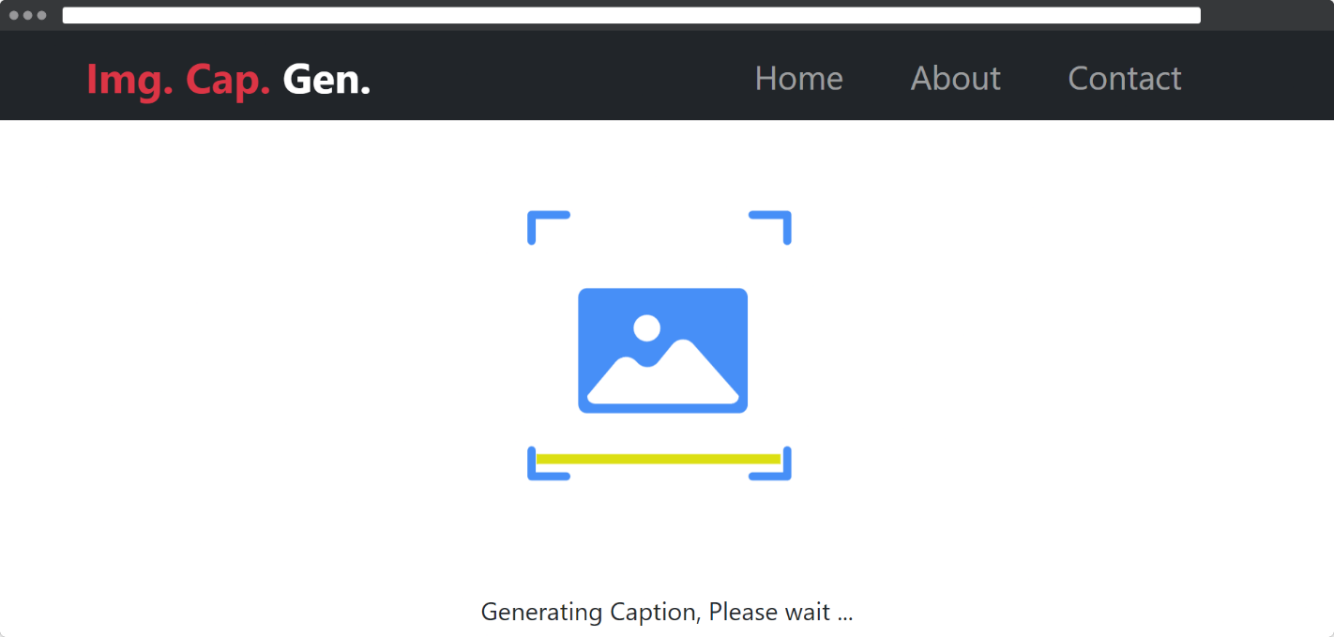
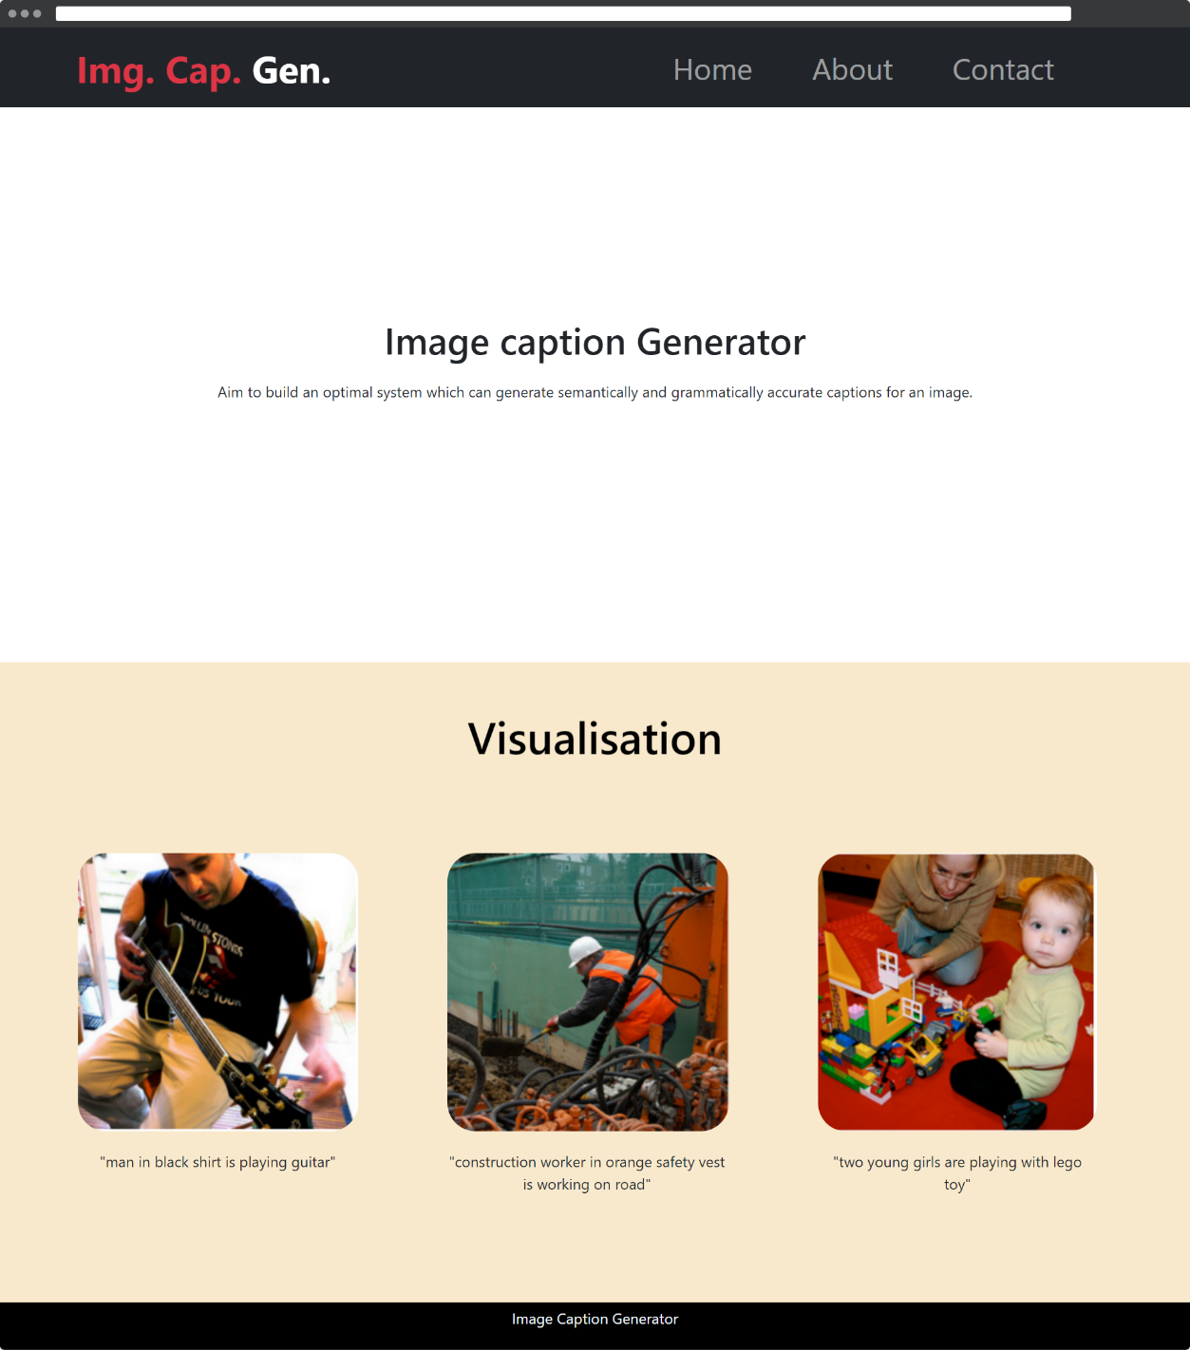
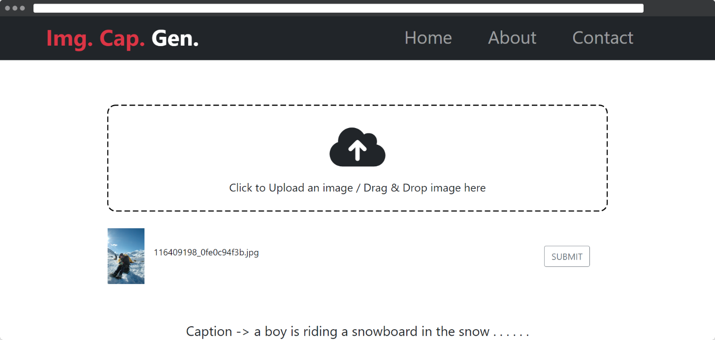

Slide 7
Software and Tech Stack Used
Python
Machine Learning
Jupyter Notebook
Kaggle
FastAPI
React
Javascript
Visual Studio Code
Git

Slide 8
Future Work
We will also implement Optical Character Recognition(OCR) which can be used for text translation for serving many different purposes.
There will be scenarios where the user does not receive desired captions; therefore, to resolve this issue, we will enlist the user's assistance by adding the appropriate caption of the image that is correct according to the user, which can then be used to retrain the model, thereby improving the accuracy of our model.
We can extend this software to serve wider audience by developing cross platform application.
We can implement this feature for key frames of the videos.

Slide 9
References
[1] CS771 Project Image Captioning by Ankit Gupta, Kartik Hira, and Bajaj Dilip.
[2] ”Every Picture Tells a Story: Generating Sentences from Images.” Computer Vision ECCV (2016) by Farhadi, Ali, Mohsen Hejrati, Mohammad Amin Sadeghi, Peter Young, Cyrus Rashtchian, Julia Hocken-Maier, and David Forsyth
[3] Automatic Caption Generation for News Images by Yansong Feng, and Mirella Lapata, IEEE (2013).
[4] Image Caption Generator Based on Deep Neural Networks by Jianhui Chen, Wenqiang Dong, and Minchen Li, ACM (2014).
[5] Show and Tell: A Neural Image Caption Generator by Oriol Vinyl, Alexander Toshev, Samy Bengio, Dumitru Erhan, IEEE (2015).
[6] Image2Text: A Multimodal Caption Generator by Chang Liu, Changhua Wang, Fuchun Sun, Yong Rui, ACM (2016).
[7] The Vanishing Gradient Problem During Learning Recurrent Neural Nets and Problem Solutions by Sepp Hochreiter.
[8] Where to put the Image in an Image Caption Generator by Marc Tanti, Albert Gatt, Kenneth P. Camilleri.

